Slide 1


Slide 2
photo
Name Here
Title
Organization
logo
presenters

Slide 3

The mission of National Faith & Blue weekend is to facilitate safer and stronger communities by engaging law enforcement officers and local residents through the connections with faith-based organizations.

Slide 4

National law enforcement partners

Slide 5

State law enforcement partners

Slide 6
2023 events

Slide 7
2023 photo contest

Slide 8
2023 highlights & metrics

Slide 9

Tools & resources

Slide 10
30 Sample Activities (10 Quick, 20 Full)
Each Full Activity Includes:
Overview, Materials Needed, Location Needed,
Role for Law Enforcement Agency, Role for House of Worship, How to Create Connections, Planning Timeline, “Day Of” Steps, Virtual Option
Getting Started, Planning, and Wrap-Up Checklists
Sample Scripts to Reach Out to Potential Co-Hosts
Sample Media Advisory
Frequently Asked Questions
The toolkit

Slide 11
1
2
3
4
Fostering Dialogue
and Understanding
Community or agency needs to discuss tough issues
Crucial Conversations
Community Dialogue
Book Discussion
Vigil for Understanding
Peace, Justice, and Unity March
Essay Contest
Cultivating Partnerships and Engagement
Focus is on building collaboration with local leaders
Community
Service Project
Special Activity:
Host a Blood Drive
Citizens’ Academy
Community
Policing Project
Creating Connections
Ties are strong or need a light first touch
Picnic/Barbeque
Athletic Event
(including Esports)
Parade
Law Enforcement
Open House*
Football Tailgate
Movie Night
Trunk or Treat
Community Tag Sale
Promoting Peace and Safety
Through Arts
and Culture
The local
arts community
is vibrant
Music Festival
Art Festival
Dance Contest
Sample activities

Slide 12
Sample activities

Slide 13
1
2
3
4
5
involve
Solutions-oriented
Community-facing
easy
interactive
at least one faith-based or other community organization and your law enforcement agency
for people to partake
and engaging
Core elements of an activity

Slide 14
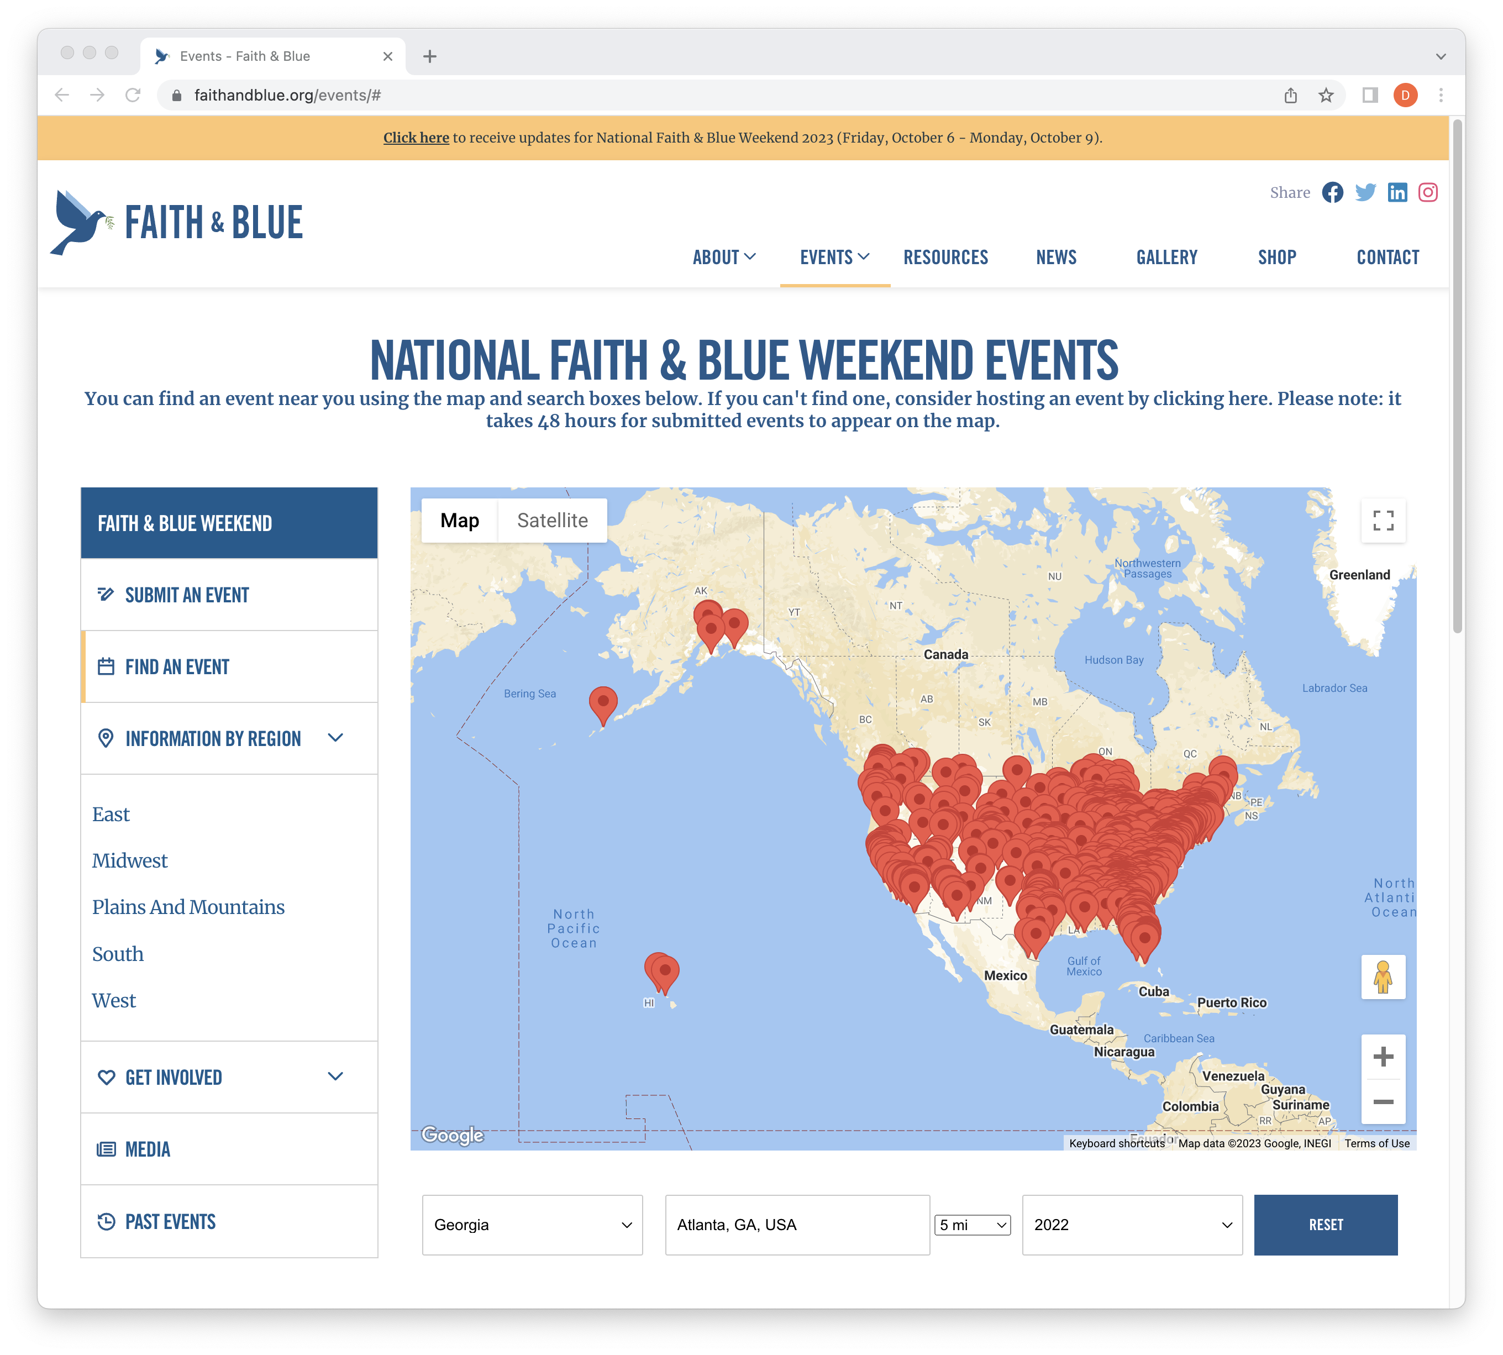
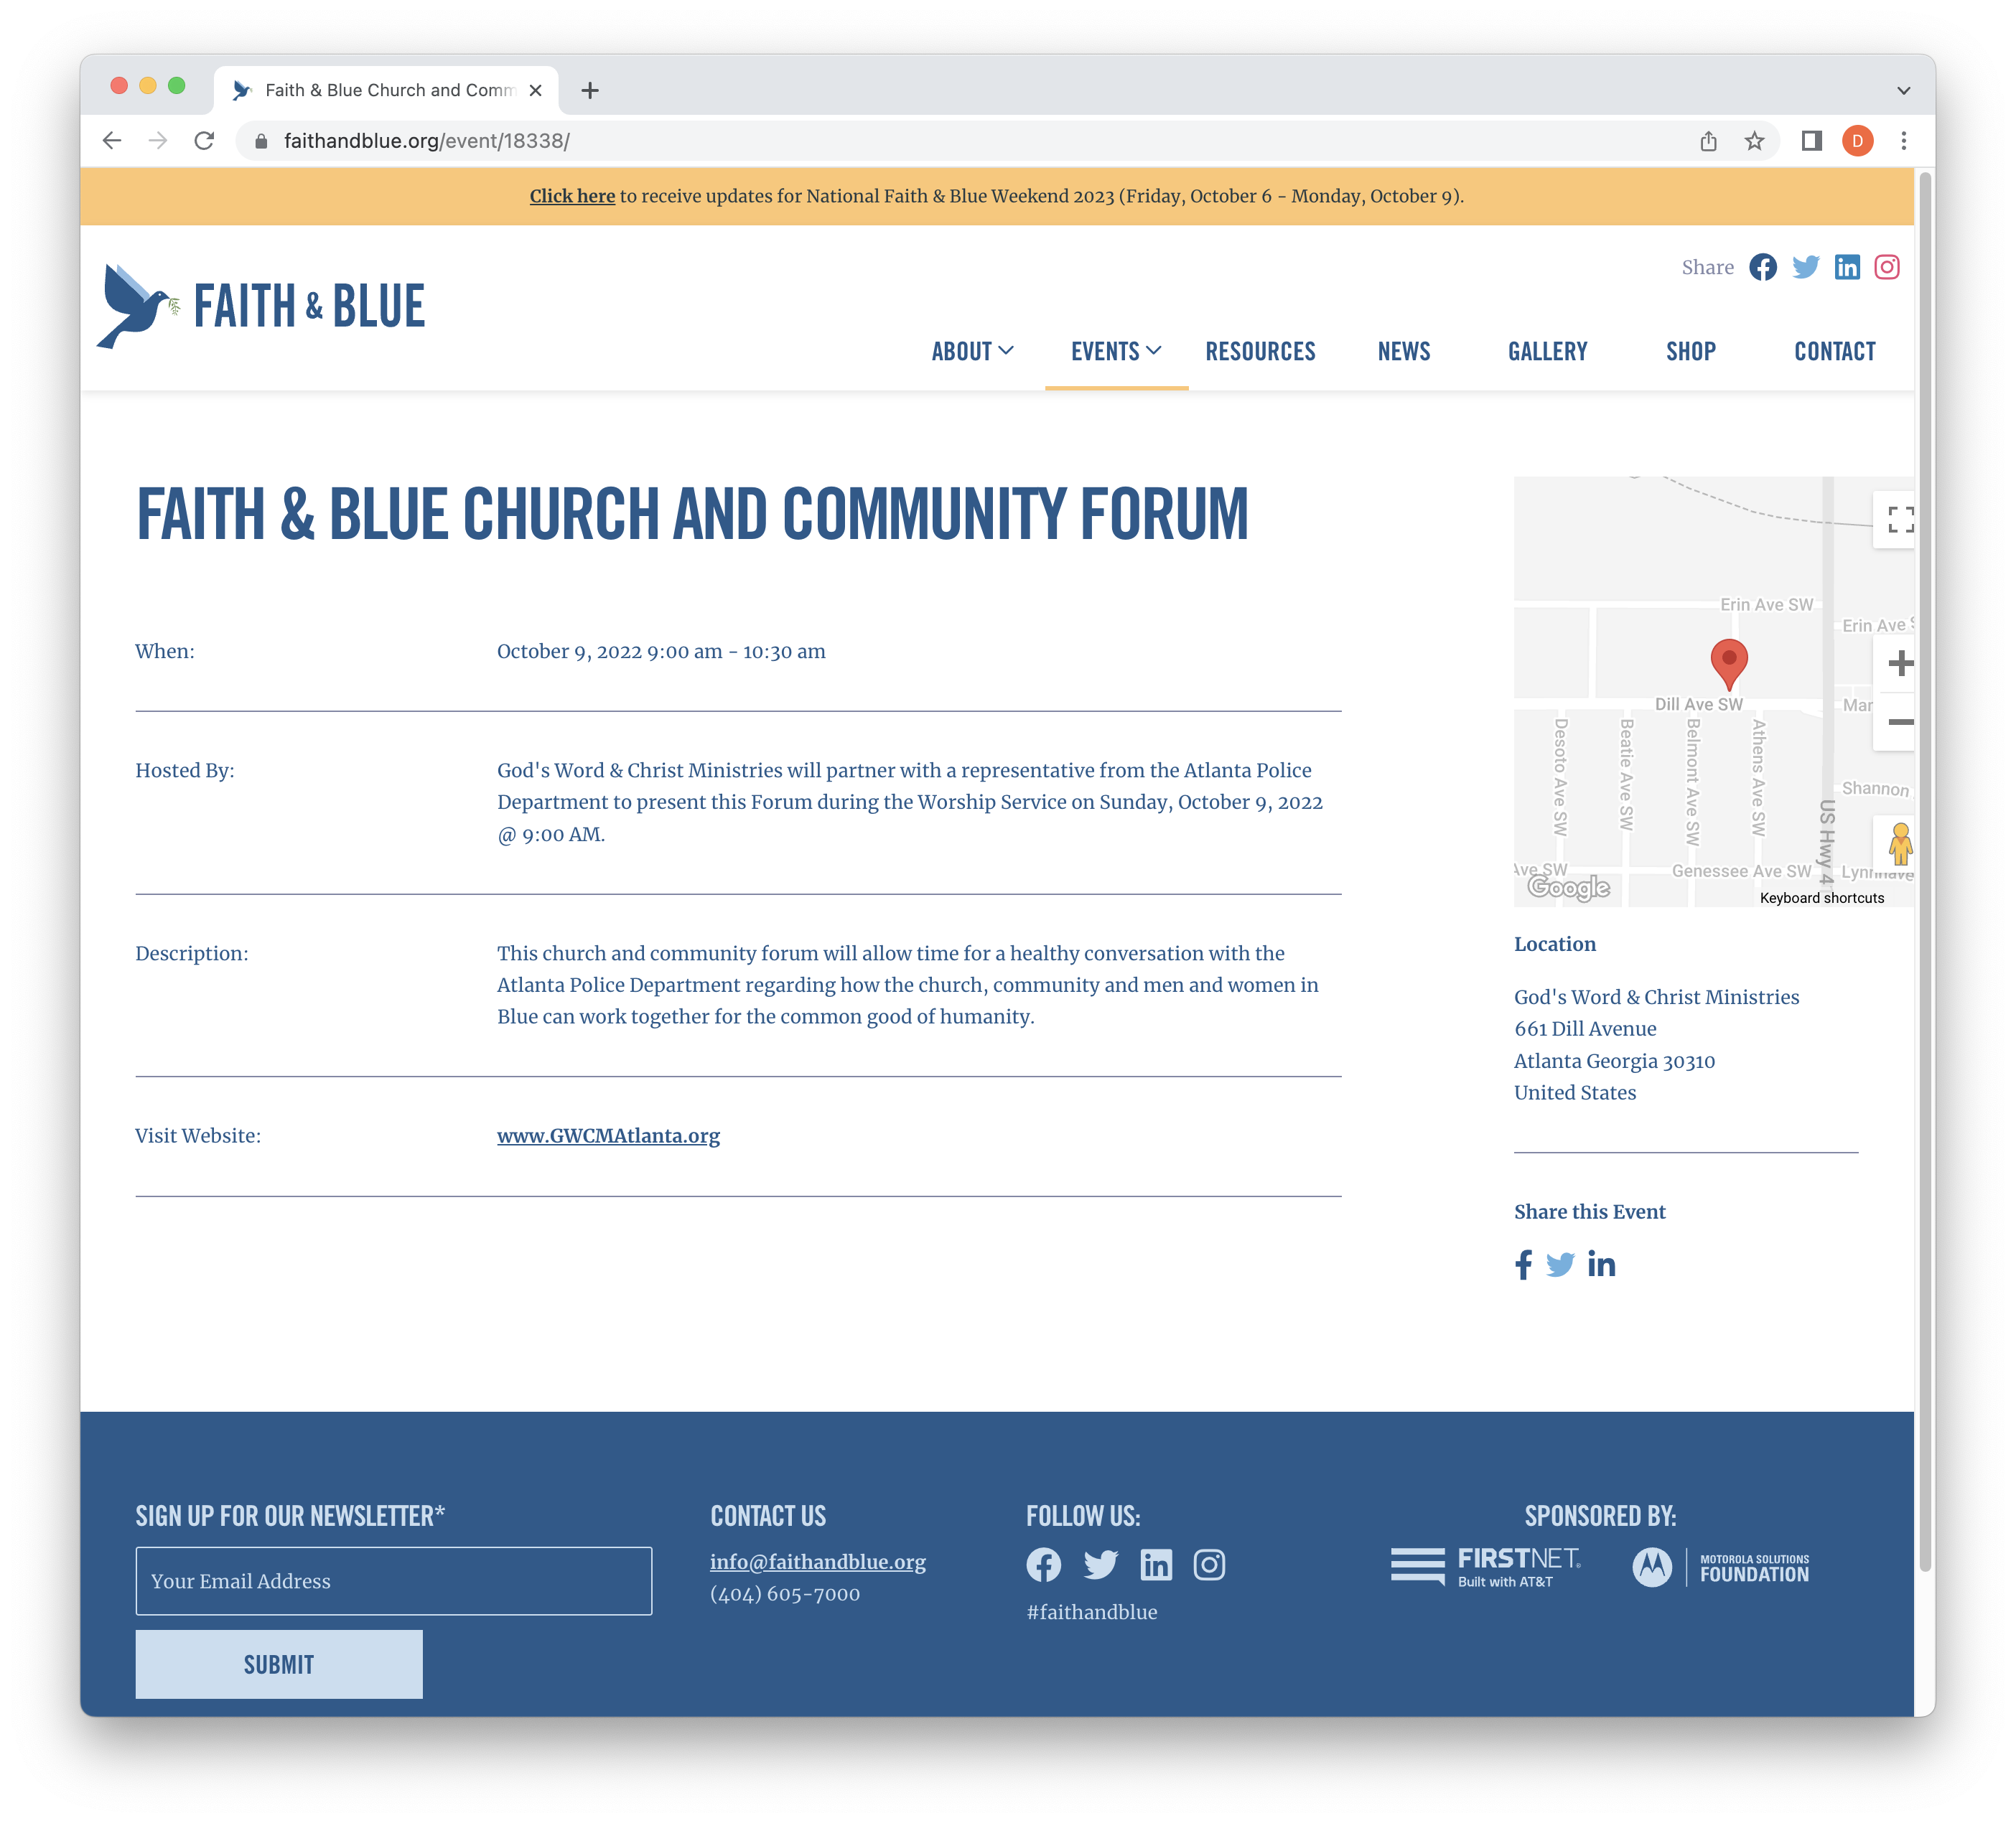
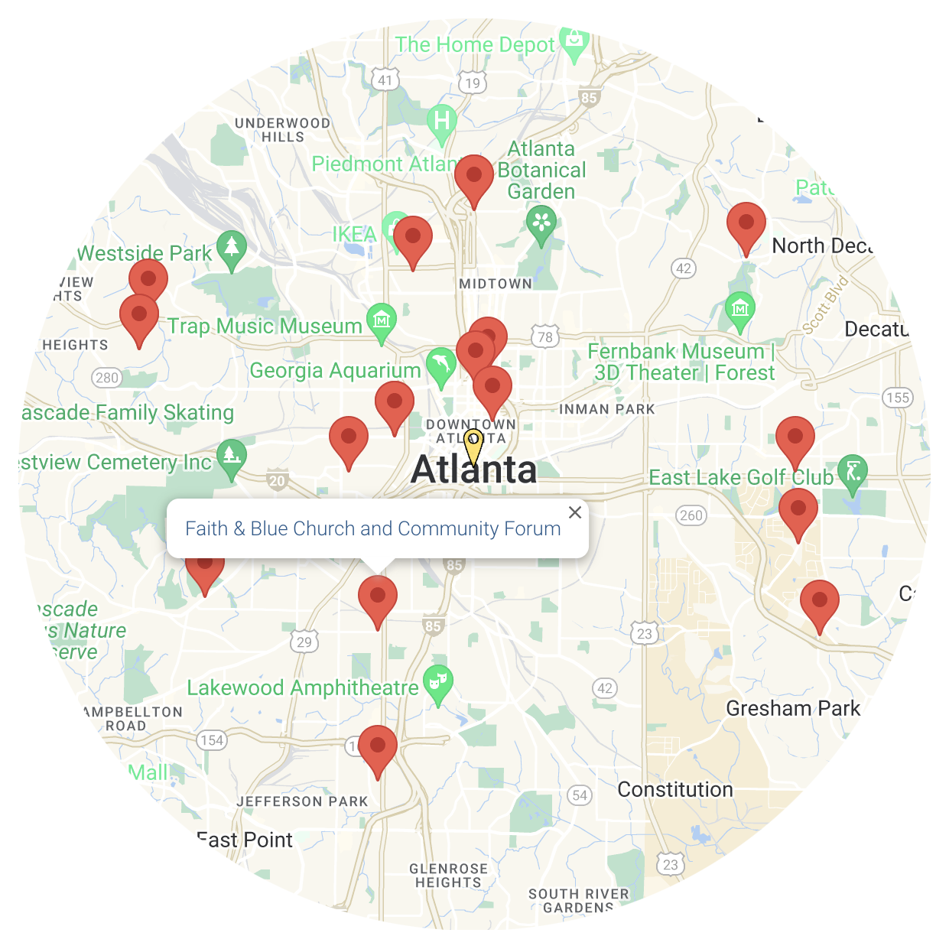
Finding an event

Slide 15
1
2
3
4
5
POST
consider
organize
engage
identify
your events early. You can finalize details later.
This allows the
national PR team to start promoting your engagements early.
coordinating “rolling tour”
of events throughout your jurisdiction.
Officers visit multiple of faith-based organizations over
the weekend.
with the faith-based organizations already associated with your agency.
Using existing relationships are a
great way to create
and build momentum.
your PIO(s) closely in your planning process.
Faith & Blue provides outstanding imagery and stories to promote your agency.
a lead organizer to manage Faith & Blue weekend throughout your agency.
This allows for continuity internally and externally.
Action steps – top lessons learned

Slide 16
Get Involved…
send
Announce
post
send
communication(s) to your congregation(s) urging them to partner with their local law enforcement agencies to host event(s). We can brand the planning toolkit with your logo.
participation publicly—on your website, in newsletters, and on social media platforms, using hashtag #FaithAndBlue
video message from your senior leader on digital platforms
Faith & Blue national office your logo for placement on website
Action steps – partnership

Slide 17
Designate a “Point of Contact”
Enables Faith & Blue to streamline correspondence to your agency or organization
Point of Contact can change!
It only takes one minute!
Please complete the form today at:
https://faithandblue.org/KeyContact
The point of contact

Slide 18
Headline
1
2
3
4
5
Action verb
Action verb
Action verb
Action verb
Action verb
sentence to describe action.
Additional info… usdandae sitatur abo. Les volo verehen imaximi nvendit lacieni hitiur? Edit es et lacilia tesciatiae estio enis volorem aditasp ienducitibus pel mod eris et porrovi duscium aliciur, odi cum eictur.
sentence to describe action.
Additional info… usdandae sitatur abo. Les volo verehen imaximi nvendit lacieni hitiur? Edit es et lacilia tesciatiae estio enis volorem aditasp ienducitibus pel mod eris et porrovi duscium aliciur, odi cum eictur.
sentence to describe action.
Additional info… usdandae sitatur abo. Les volo verehen imaximi nvendit lacieni hitiur? Edit es et lacilia tesciatiae estio enis volorem aditasp ienducitibus pel mod eris et porrovi duscium aliciur, odi cum eictur.
sentence to describe action.
Additional info… usdandae sitatur abo. Les volo verehen imaximi nvendit lacieni hitiur? Edit es et lacilia tesciatiae estio enis volorem aditasp ienducitibus pel mod eris et porrovi duscium aliciur, odi cum eictur.
sentence to describe action.
Additional info… usdandae sitatur abo. Les volo verehen imaximi nvendit lacieni hitiur? Edit es et lacilia tesciatiae estio enis volorem aditasp ienducitibus pel mod eris et porrovi duscium aliciur, odi cum eictur.
Promoting your event
I will have new text for here, but we’d like a headline and then bullet points that can be customized. It’s going to be about promoting the event and explain how it connects to the marquee events

Slide 19
Friday
October 11
Saturday
October 12
Sunday
October 13
Monday
October 14
🎉
Event 7:
Law Enforcement Open House
Event 8:
Community Forum
Close out!
Post-closing Reflections & Images on Social Media
Event day
kick off!
Post on Social Media
Event 1:
Visit our Seniors
Event 2:
Movie Night
Event 3:
Athletic Event
and/or
Event 4:
Picnic/Barbeque
Event 5:
Rolling Tour/
Sending Greetings
Event 6:
Football Tailgate
Number of Events/Activities Accomplished 8+
Sample activities schedule

Slide 20

Jared Feuer
Executive Director
jared.feuer@faithandblue.org
404.605.7000
Angela Yarbrough
Executive Administrator
angela.yarbrough@faithandblue.org
404.605.7000
Contact information

